Slide 1
Chem 108: Class/ Lab
Week 14: 2019f
Sign in / Pick up Papers
Due Today:
1) Fluid Exchange (Handout)
2) Acid-Base: pH (Handout) 1 completed form per group with names of all who contributed
Do Today: Laboratory Manual Acid & Base Titration Procedure (pp. 91-93)
Each of you are to take a clean 250 mL erlenmeyer flask and place it in the gray plastic tub on the lab’s side bench.

Slide 2
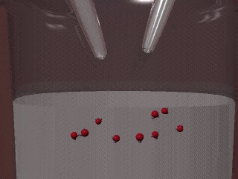
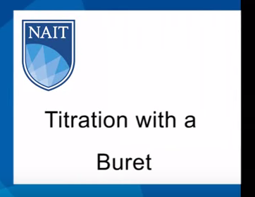
Neutralization Reactions
Titration
https://www.youtube.com/watch?v=9DkB82xLvNE
http://chemconnections.org/general/movies/acidbasetitration.mov
H⁺_{(aq)} + OH ⁻_{(aq)} H₂O_{(l)}
H₃O⁺_{(aq)} + OH ⁻_{(aq)} H₂O_{(l)}

Slide 3

Neutralizations / Titrations
Chem 108 titration: phenolphthalein indicator
Chem 120/121 Titration Curves

Slide 4
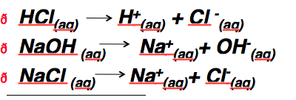
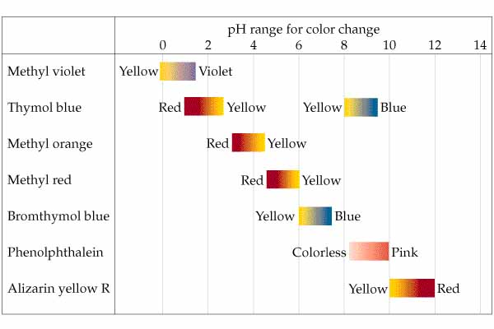
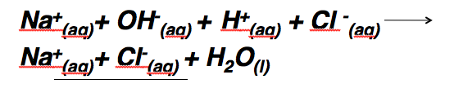
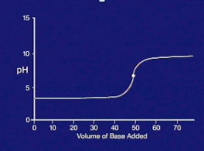
Aqueous Reactions: Neutralization
Net Ionic Equations
HCl_{(aq)} + NaOH _{(aq)} NaCl _{(aq)} + H₂O_{(l)}
Titration
end point
pH > 7
strong acid
base
salt
water
H⁺_{(aq)} + OH ⁻_{(aq)} H₂O_{(l)}
Equivalence point: pH = 7

Slide 5
Aqueous Reactions: Neutralization
Net Ionic Equations
CH₃COOH_{(aq)} + NaOH _{(aq)} CH₃COONa _{(aq)} + H₂O_{(l)}
CH₃COO-_{(aq)} + H⁺_{(aq)} + Na⁺_{(aq)} + OH⁻ _{(aq)}
CH₃COO-_{(aq)} + Na⁺_{(aq)} + H₂O_{(l)}
weak acid
base
salt
water
Titration
end point
pH > 7
H⁺_{(aq)} + OH ⁻_{(aq)} H₂O_{(l)}
Same Net Ionic Equation (NIE) for any neutralization
Eg. H₂SO₄ 2 H⁺_{(aq)} + 2 OH ⁻_{(aq)} 2 H₂O_{(l)}
__________________________
2
Equivalence point: pH = ?

Slide 6
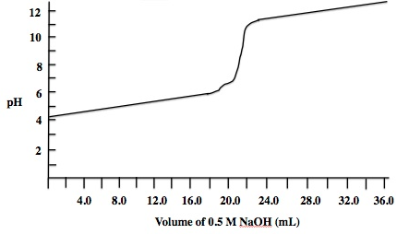
Aqueous Reactions: Neutralization
Salt in this case is a Weak Base
CH₃COOH_{(aq)} + NaOH _{(aq)} CH₃COONa _{(aq)} + H₂O_{(l)}
CH₃COO-_{(aq)} + H₂O_{(aq)} CH₃COOH_{(aq)} + OH⁻ _{(aq)}
weak acid
base
salt
water
________________________________________________
salt
+ Na⁺_{(aq)}
+ Na⁺_{(aq)}
Equivalence point pH >7
Titration
End point
pH > 7
Equivalence point: pH = ?

Slide 7
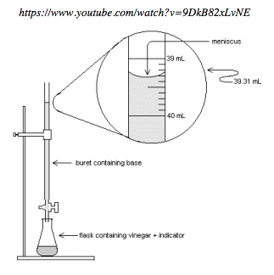
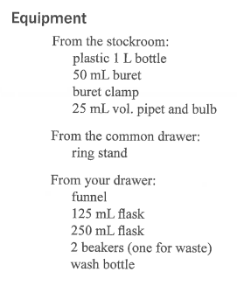
Acid-Base Titration
Part 1: Standardization will NOT be done.
Part 2: Will be done individually.

Slide 8
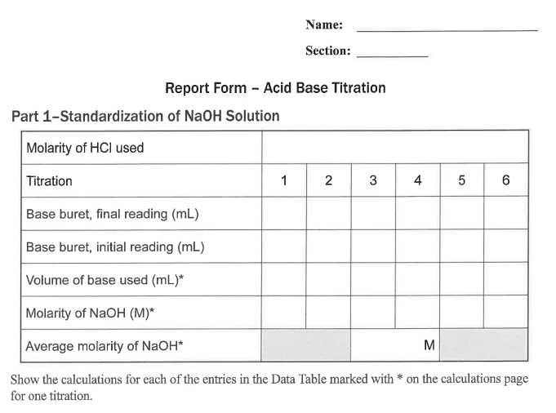
Chem 108: Lab
Week 14
Part 1 will not be done by you.
It has been done for you.
0.2240
Record and use the molarity above, 0.2240M.
Notes:
A 3900-year-old clay tablet, which was found in Iraq between the Tigris and Euphrates rivers, had a Sumerian poem (http://www.piney.com/BabNinkasi.html) honoring Ninkasi, the patron goddess of brewing. It contains the oldest surviving beer recipe, describing the fermentation of the carbohydrates found in bread, bappir, made from barley, honey, dates and sweet aromatic herbs. The global availability of carbohydrates and native microbes (yeasts) has led to the production of many different types of beers, ales, wines, and fruit based alcoholic beverages in many countries throughout the world. [The bottle on the left was found in Eugene, Oregon, ……. But, it dates only to 2016.]

Slide 9
Unkown Acid Neutralization
Net Ionic Equation/ Calculation
HNO_{3(aq)} + NaOH _{(aq)} NaNO₃ _{(aq)} + H₂O_{(l)}
acid
base
salt
water
conj. base
conj. acid
H⁺_{(aq)} + OH ⁻_{(aq)} H₂O_{(l)}
acid
base
water
  25.00 mL of M_{H+ (aq)}= ? (unknown monoprotic nitric acid solution) was titrated with a sodium hydroxide solution, M_{OH-}= ? 0.2162 M. It required 24.20 mL as an average of three trials which were within +/- 0.20 mL to reach a faint pink color.
  M_{H+ (aq)} = ?
?M_{H+} = [M_{OH-} x V_{OH-} / V_{H+} ] [? mol_{H+} / ? mol_{OH-}]

Slide 10
Unkown Acid Neutralization
Net Ionic Equation/ Calculation
H⁺_{(aq)} + OH ⁻_{(aq)} H₂O_{(l)}
acid
base
water
  25.00 mL of M_{H+ aq}= ? (unknown monoprotic acid solution) was titrated with a sodium hydroxide solution, M_{OH-}= ? 0.2162 M. It required 24.20 mL as an average of three trials which were within +/- 0.20 mL to reach a faint pink color.
?M_{H+} = [M_{OH-} x V_{OH-} / V_{H+} ] [? mol_{H+} / ? mol_{OH-}]
0.2162 mol_{OH-} x 0.02420 L_{OH-} x 1 mol_{H+}
L_{OH-} x 0.02500 L_{H+} x 1 mol_{OH-}
=
= 0.2093 M_{H+}

Slide 11
QUESTION
A 35.00 mL sample of a monoprotic acid of unknown concentration was titrated with 42.30 mL of 0.2250 M KOH. What is the concentration of the unknown acid?
0.0930 M
0.3030 M
0.2719 M
0.1356 M
0.3720 M
H⁺_{(aq)} + OH ⁻_{(aq)} H₂O_{(l)}
?M_{H+} = [M_{OH-} x V_{OH-} / V_{H+} ] [? mol_{H+} / ? mol_{OH-}]

Slide 12
QUESTION
A 35.00 mL sample of sulfuric acid (a di-protic acid) of unknown concentration was titrated with 42.30 mL of 0.2250 M KOH. What is the concentration of the unknown acid?
0.0930 M
0.3030 M
0.2719 M
0.1356 M
0.3720 M
1
H₂SO₄
2
2
H⁺_{(aq)} + OH ⁻_{(aq)} H₂O_{(l)}
? M_{H+} = [M_{OH-} x V_{OH-} / V_{H+} ] [? mol_{H2SO4} / ? mol_{OH-}]

Slide 13
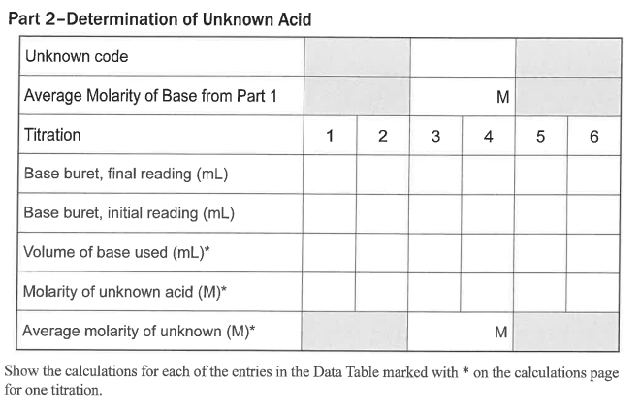
Chem 108: Lab
Part 2: Week 13
To Do today (individually); each of you will do a separate unknown.
_____
0.2240
3 trials must be within
+/- 0.20 mL
1mL ~ 20 drops
Each of you will do a separate unknown. Take an erlenmeyer flask from the gray tub and record its code & the Molarity of Base.
Notes:
A 3900-year-old clay tablet, which was found in Iraq between the Tigris and Euphrates rivers, had a Sumerian poem (http://www.piney.com/BabNinkasi.html) honoring Ninkasi, the patron goddess of brewing. It contains the oldest surviving beer recipe, describing the fermentation of the carbohydrates found in bread, bappir, made from barley, honey, dates and sweet aromatic herbs. The global availability of carbohydrates and native microbes (yeasts) has led to the production of many different types of beers, ales, wines, and fruit based alcoholic beverages in many countries throughout the world. [The bottle on the left was found in Eugene, Oregon, ……. But, it dates only to 2016.]

Slide 14
Chem 108: Lab
Part 2: Week 13
To Do today (individually); each of you will do a separate unknown.
_____
0.2240
3 trials must be within
+/- 0.20 mL
1mL ~ 20 drops
After completing enough trials that 3 of them are within
+/- 0.20 mL show this data page to Dr. R.
Notes:
A 3900-year-old clay tablet, which was found in Iraq between the Tigris and Euphrates rivers, had a Sumerian poem (http://www.piney.com/BabNinkasi.html) honoring Ninkasi, the patron goddess of brewing. It contains the oldest surviving beer recipe, describing the fermentation of the carbohydrates found in bread, bappir, made from barley, honey, dates and sweet aromatic herbs. The global availability of carbohydrates and native microbes (yeasts) has led to the production of many different types of beers, ales, wines, and fruit based alcoholic beverages in many countries throughout the world. [The bottle on the left was found in Eugene, Oregon, ……. But, it dates only to 2016.]

